Slide 1

Review Analysis of British airways
-Mangesh Patil

Slide 2
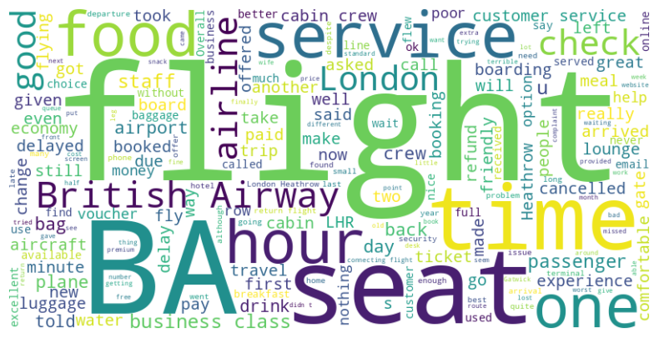
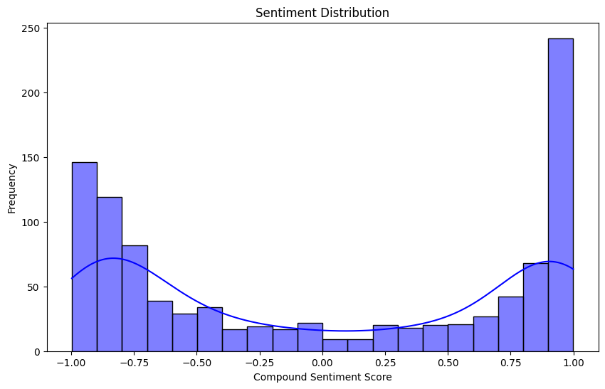
Key findings from Analysis
Neutral Overall: The average sentiment score is 0.00, indicating a neutral sentiment across all reviews.
Slight Negativity: Despite the neutral average, 51.90% of the reviews are negative, suggesting a slight skew towards negativity.
Mixed Sentiments: Both positive and negative sentiments indicate diverse opinions and experiences among reviewers.
Areas for Improvement: Negative sentiments highlight potential areas for improvement or issues to address in the product, service, or customer experience.
The word cloud visualization provides a quick and intuitive overview of the most frequently occurring words in the reviews.
This visual representation helps identify prominent themes or topics mentioned by reviewers, offering insights into the most common aspects of their experiences or opinions.

